Slide 1

Virtual Internship
Task-2
-Srihridai

Slide 2

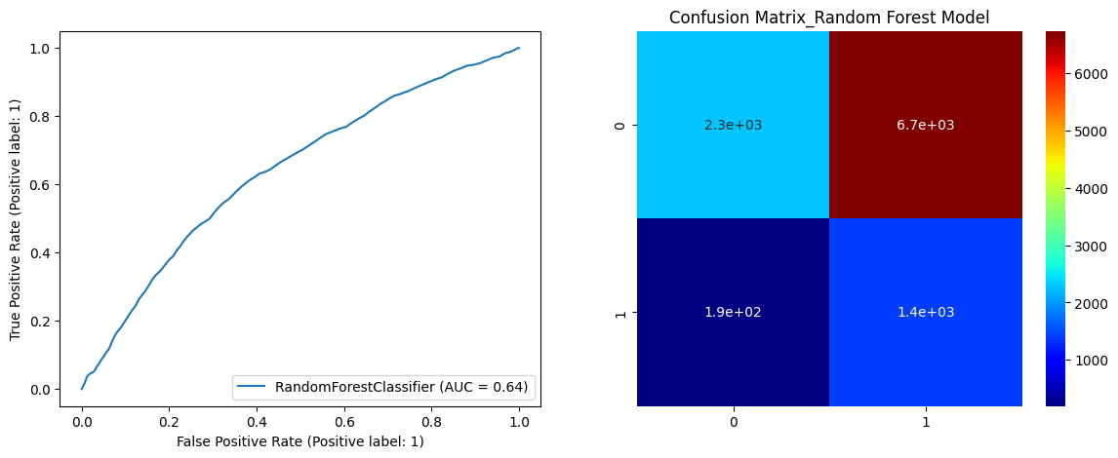
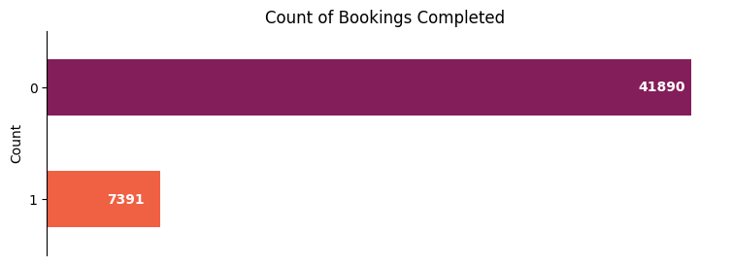
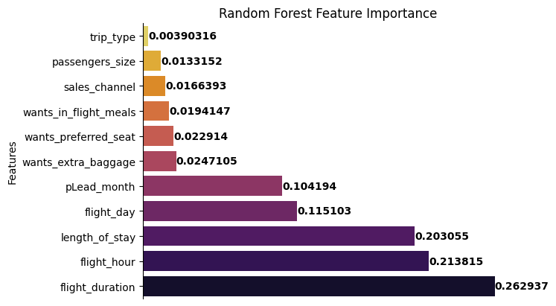
Customer Booking Completion Prediction
This is a binary classification problem
Data is imbalanced
SMOTEENN technique is implemented to balance the data
Performance Metrics
Feature Importance
Confusion Matrix

